Slide 1
JQuery Templates

Slide 2
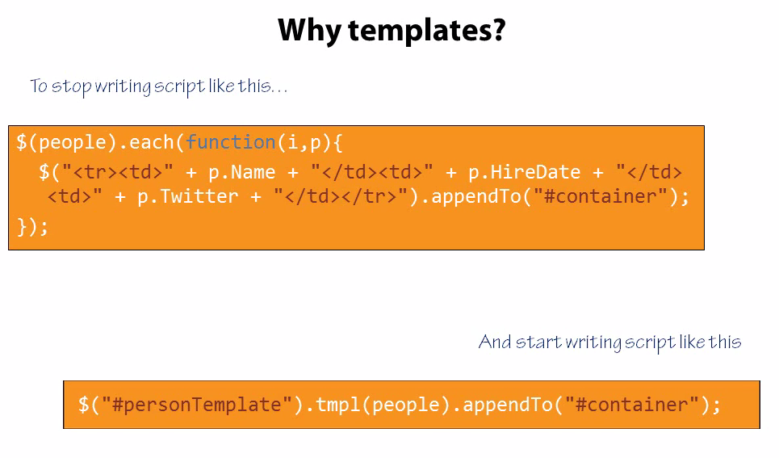
Separation data from the html

Slide 3
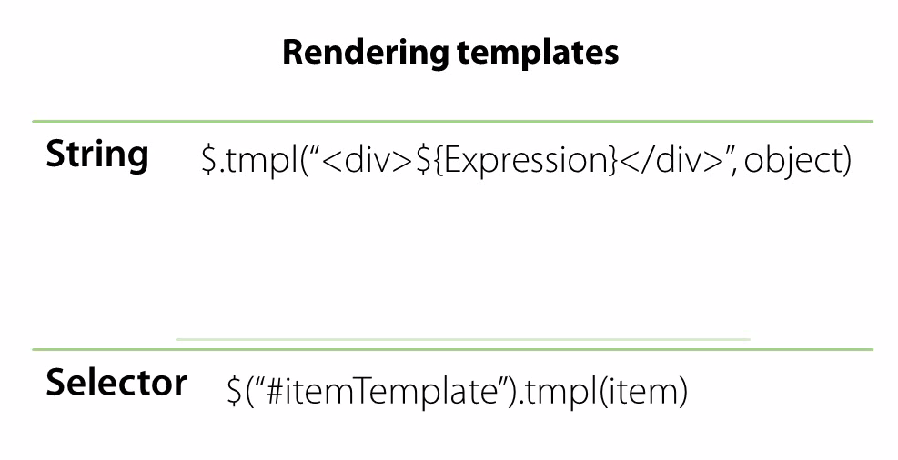

Slide 4


Slide 5


Slide 6


Slide 7
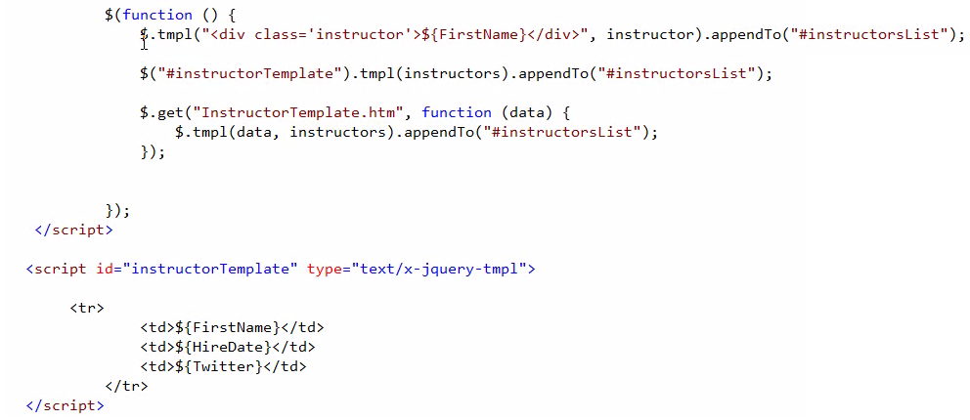

Slide 8
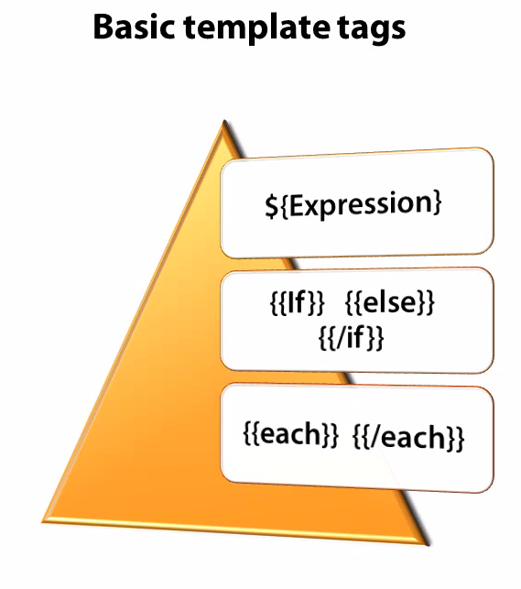

Slide 9


Slide 10
